Slide 1





Slide 2

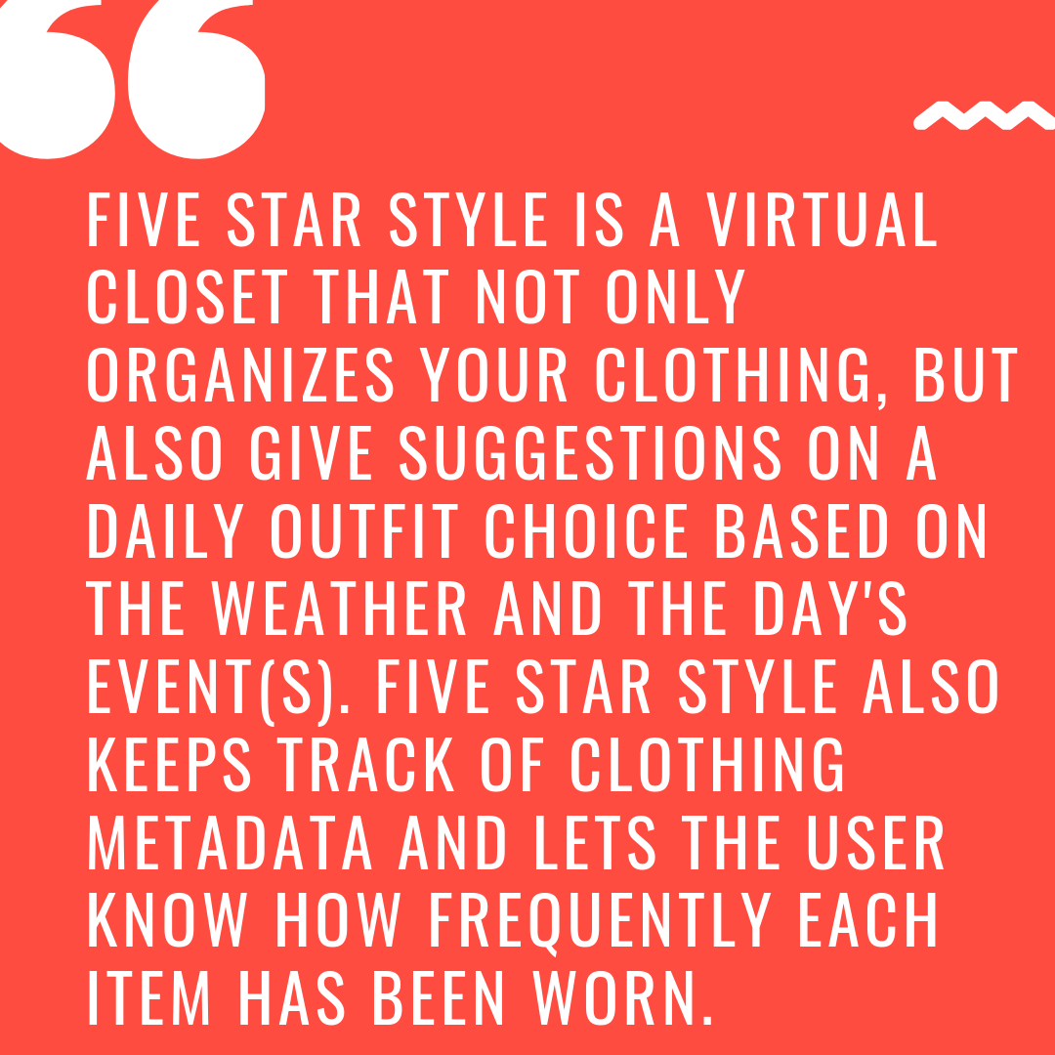
Notes:
Megan

Slide 3
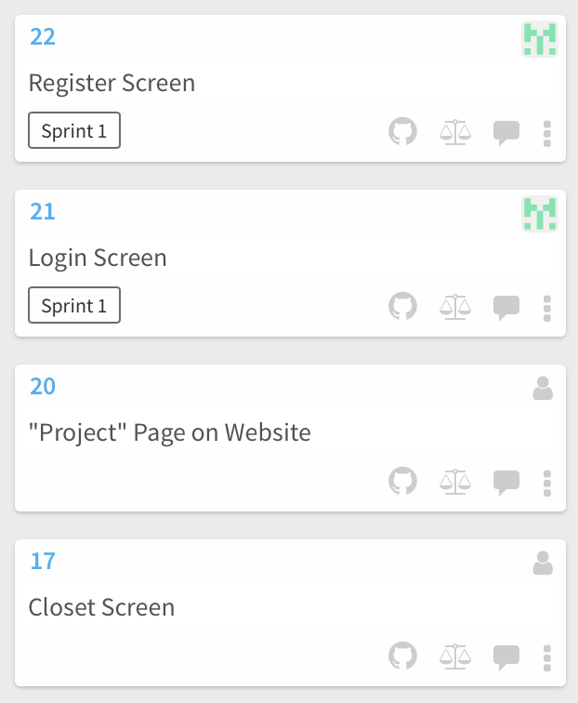
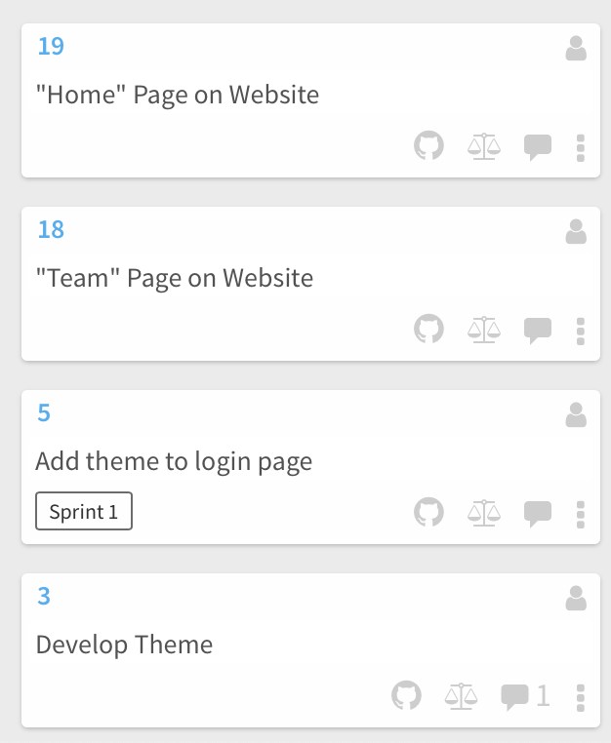
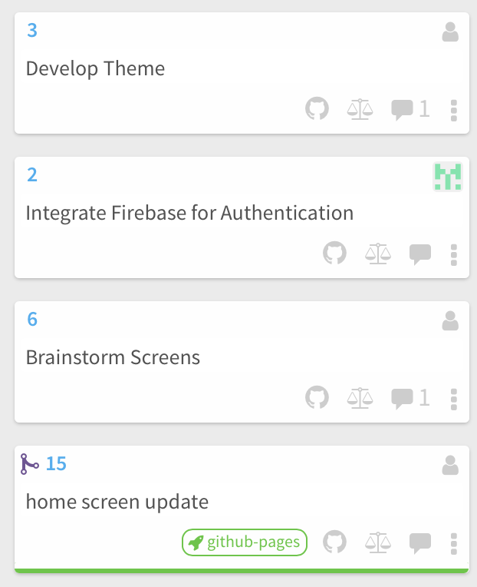
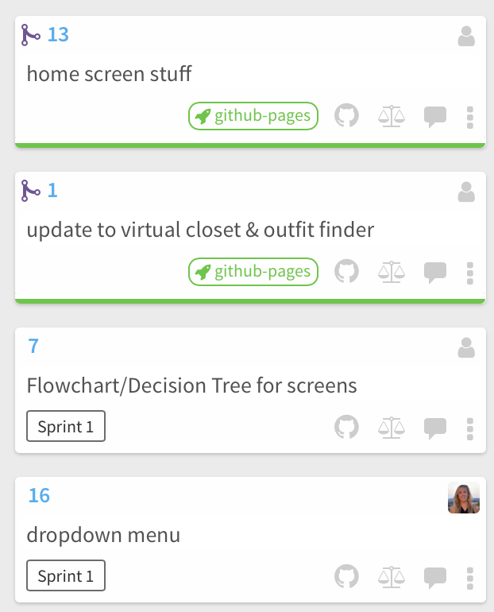
Sprint Backlog
Sprint Backlog
Notes:
Abigail

Slide 4
Reflections
Challenges faced
Learned a lot about android studio
Discovered how we work best as a team
Scrum Meetings
Sprint Backlog
Github Issues
Overall Application theme
Integrating firebase api
Notes:
Autumn

Slide 5

Add Functionality to each screen
Integrate more APIs
database calls on the closet screen
Photo analyzer for importing pictures
Notes:
Caley

